Slide 1
PV239 - 01 Introduction

Slide 2
Introduction
Introduction
.NET MAUI
Setup
Layouts
Controls
Roman
Ondřej
And what about you?

Slide 3
Exercises
Introduction
.NET MAUI
Setup
Layouts
Controls
Introduction
Design – XAML
Architecture – MVVM
Architecture – IoC/DI
Storage
Networking – API

Slide 4
goals
Introduction
.NET MAUI
Setup
Layouts
Controls
Course organization
Get in touch with .NET MAUI
Go through environment setup
Get to know available layouts and controls

Slide 5
Course Organization
Introduction
.NET MAUI
Setup
Layouts
Controls
Interactive syllabi – IS
Materials
Materials repository: https://github.com/jasho/pv239-maui
Sample app repository: https://github.com/jasho/cookbook-maui
Stream/recordings – Youtube
https://www.youtube.com/playlist?list=PLMD3_JXajX1iWN-KFRie7esaE9NP7eBlf
Excercises
Homework
Project

Slide 6
Sample application
Introduction
.NET MAUI
Setup
Layouts
Controls
CookBook
Android, iOS, Windows
Communication with API
Basic CRUD operations
Saving of settings
MVVM architecture
Shell navigation

Slide 7




“Standard“ Application Development
Introduction
.NET MAUI
Setup
Layouts
Controls
iOS
Objective-C
Swift
XCode
Android
Java
Kotlin
Android Studio
Windows
C#
Visual Studio
Mac OS
Objective-C
Swift
XCode

Slide 8




.NET Multi-platform App UI
Introduction
.NET MAUI
Setup
Layouts
Controls
.NET 7
Cross-platform, native UI
Single project system, single codebase
Deploy to multiple devices, mobile & desktop
.NET MAUI
Android
iOS
macOS
Windows

Slide 9
How It Works - Structure
Introduction
.NET MAUI
Setup
Layouts
Controls
Platform specific frameworks
.NET for Android
.NET for iOS
.NET for MacOS
Windows UI (WinUI) library
Common BCL - .NET
.NET Runtimes
Mono – Android, iOS, MacOS
WinRT/Win32 – Windows

Slide 10
How It Works - UI
Introduction
.NET MAUI
Setup
Layouts
Controls
Platform specific UI
Different platforms - different ways of defining UI
Can be defined separately using platform specific APIs
.NET for Android, .NET for iOS, .NET for MacOs, WinUI
Common UI
Single framework for defining UI – mobile & desktop
XAML

Slide 11
How It Works - Android
Introduction
.NET MAUI
Setup
Layouts
Controls
C# compiles to intermediate language (IL)
IL + JIT in app
IL + JIT
.NET
JIT
.AAB
C#
Bindings
Runs
natively
Notes:
AAB – Android App Bundle

Slide 12
How it Works - iOS
Introduction
.NET MAUI
Setup
Layouts
Controls
Fully ahead-of-time (AOT) compiled to native ARM binary
ARM
BINARY
.NET
AOT
.IPA
C#
Bindings
Runs
natively

Slide 13
How It Works – MacOS & Windows
Introduction
.NET MAUI
Setup
Layouts
Controls
MacOS
Using Mac Catalyst
Apple’s solution to bring iOS Apps to desktop
Provides access to Mac OS APIs
Windows
WinUI 3 library
Native apps and UWP

Slide 14
How .NET MAUI Works
Introduction
.NET MAUI
Setup
Layouts
Controls
Application Code
.NET MAUI
.NET for Android
.NET for iOS
.NET for Mac
WinUI 3
.NET BCL
Mono Runtime
Win32/WinRT
Android
iOS
macOS
Windows

Slide 15
.NET MAUI
Introduction
.NET MAUI
Setup
Layouts
Controls
Collection of Controls
Layout engine for pages
Navigation – pages, drawers
Customizable handlers – enable platform specific controls
APIs for native device features – GPS, accelerometer…
Graphics library for 2D drawing code
Single project, multi-targeting system
.NET hot reload

Slide 16


SETUP
Introduction
.NET MAUI
Setup
Layouts
Controls
Visual Studio
for Windows
.NET MAUI
extension for VS Code

Slide 17
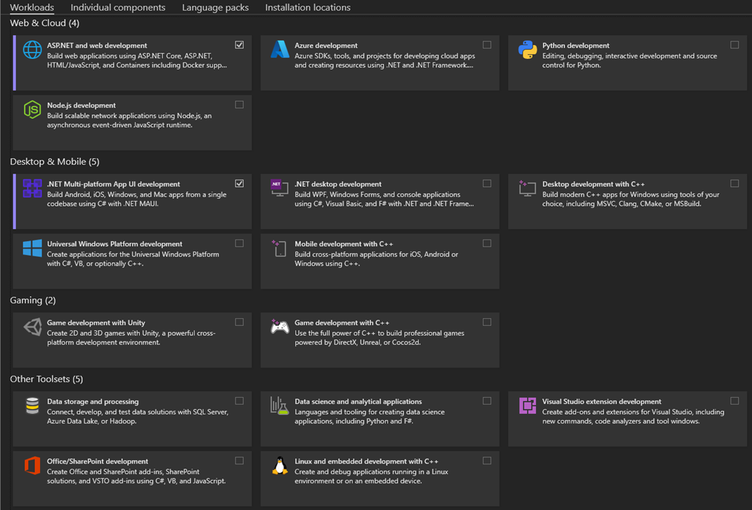
Visual studio workloads
Introduction
.NET MAUI
Setup
Layouts
Controls

Slide 18
Ios development
Introduction
.NET MAUI
Setup
Layouts
Controls
You need Mac Agent to compile the application
Compilation runs on a Mac OS device
Simulator and development can be done on Windows

Slide 19
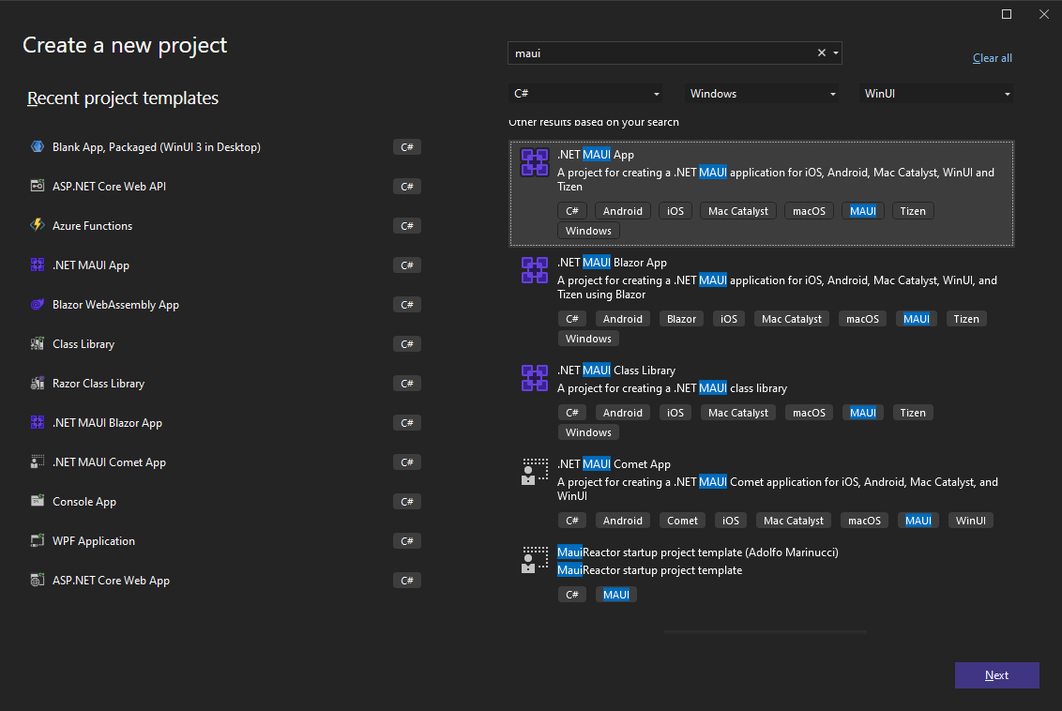
Create a new project
Introduction
.NET MAUI
Setup
Layouts
Controls

Slide 20
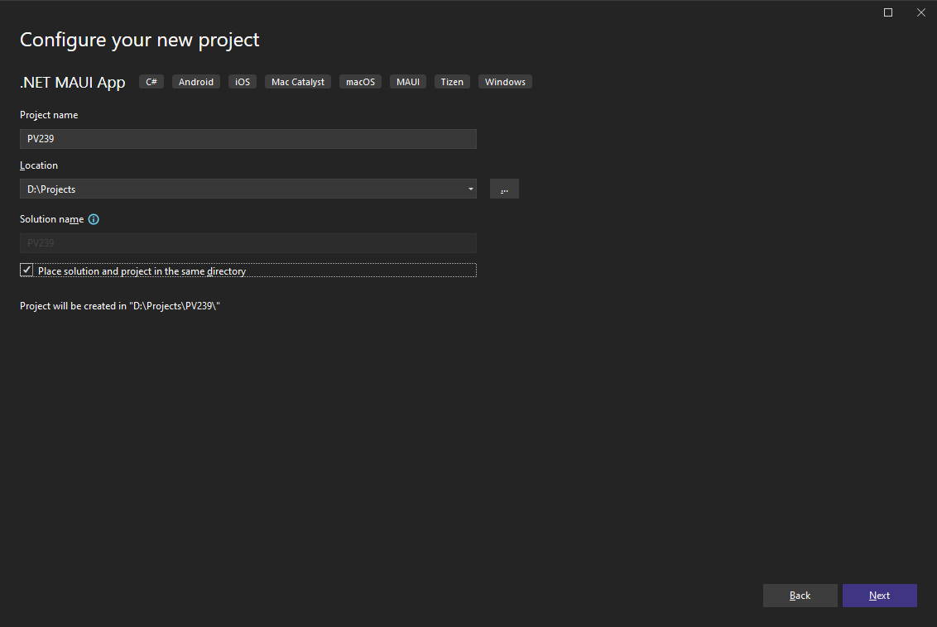
Create a new project
Introduction
.NET MAUI
Setup
Layouts
Controls

Slide 21
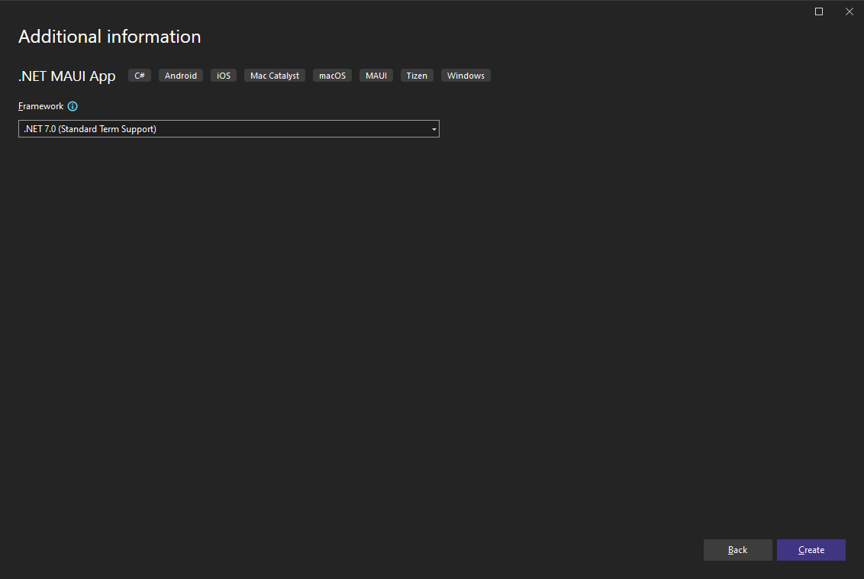
Create a new project
Introduction
.NET MAUI
Setup
Layouts
Controls

Slide 22
Create a new project
Introduction
.NET MAUI
Setup
Layouts
Controls
Demo

Slide 23
Project structure
Introduction
.NET MAUI
Setup
Layouts
Controls
One project for all platforms
Shared code & resources (fonts, images, icons, splash screens…)
Platforms folder:
Android – system colors, manifest
iOS – launch screen, Info.plist
Windows – package manifest, app manifest
Mac OS – Info.plist
Each platform
Application startup point
Custom handlers for application specific controls

Slide 24
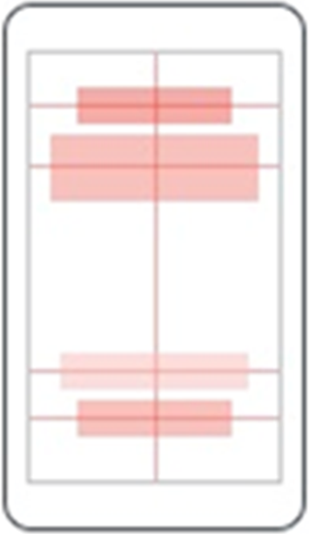
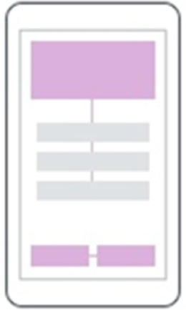
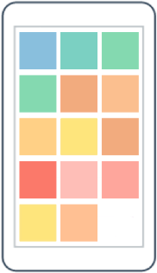
Layouts
Introduction
.NET MAUI
Setup
Layouts
Controls
AbsoluteLayout
RelativeLayout
FlexLayout

Slide 25
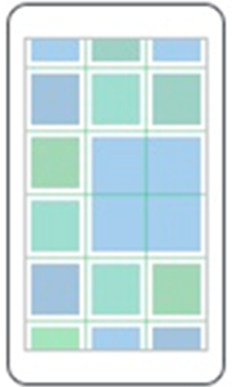
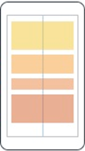
Layouts
Introduction
.NET MAUI
Setup
Layouts
Controls
Grid
StackLayout

Slide 26
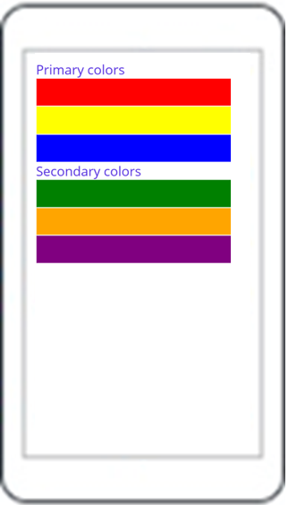
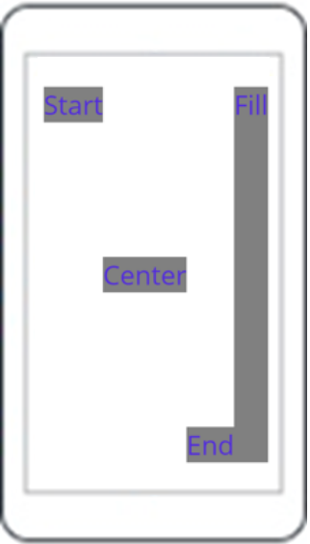
Layouts – StackLayout
Introduction
.NET MAUI
Setup
Layouts
Controls
StackLayout
VerticalStackLayout
HorizontalStackLayout

Slide 27
Grid
Introduction
.NET MAUI
Setup
Layouts
Controls
Table-style layout
RowDefinitions, ColumnDefinitions
Width / Height = 150 | * | Auto
Grid.Row, Grid.Column – placement of control in the Grid
Grid.RowSpan, Grid.ColumnSpan – control can span over multiple “cells”
HorizontalSpacing, VerticalSpacing – empty space between “cells”

Slide 28
StackLayout…
Introduction
.NET MAUI
Setup
Layouts
Controls
HorizontalStackLayout, VerticalStackLayout
Individual layouts for single direction
Separate LayoutManagers with Measure methods
Recommended
StackLayout
Wraps HorizontalStackLayout and VerticalStackLayout
Has Orientation
Useful for adaptive layouts

Slide 29
Layouts
Introduction
.NET MAUI
Setup
Layouts
Controls
Demo

Slide 30
Controls
Introduction
.NET MAUI
Setup
Layouts
Controls
ActivityIndicator
BoxView
Button
DatePicker
Editor
Entry
Image
Label
TimePicker
Slider
OpenGLView
Picker
ProgressBar
SearchBar
Stepper
WebView
TableView
ListView
TextCell
EntryCell
ImageCell
SwitchCell
ViewCell
Map
…

Slide 31
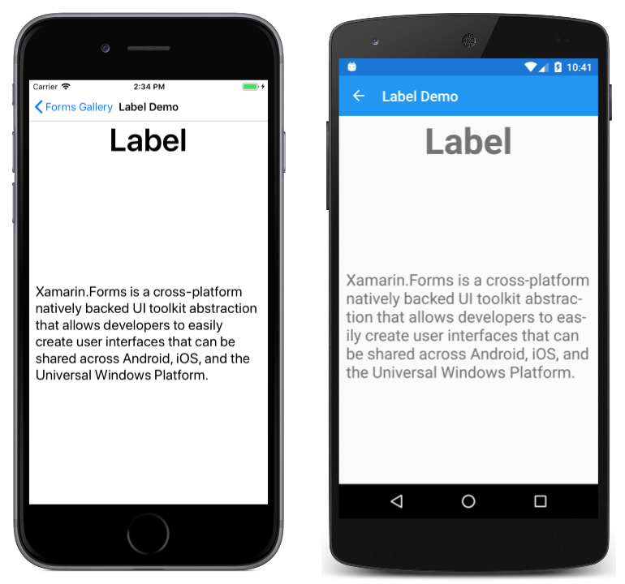
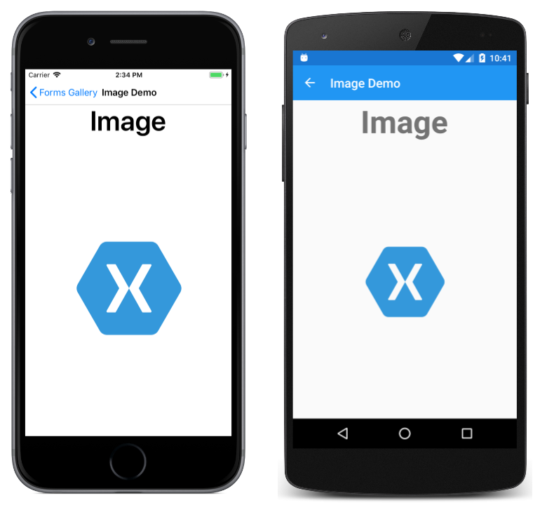
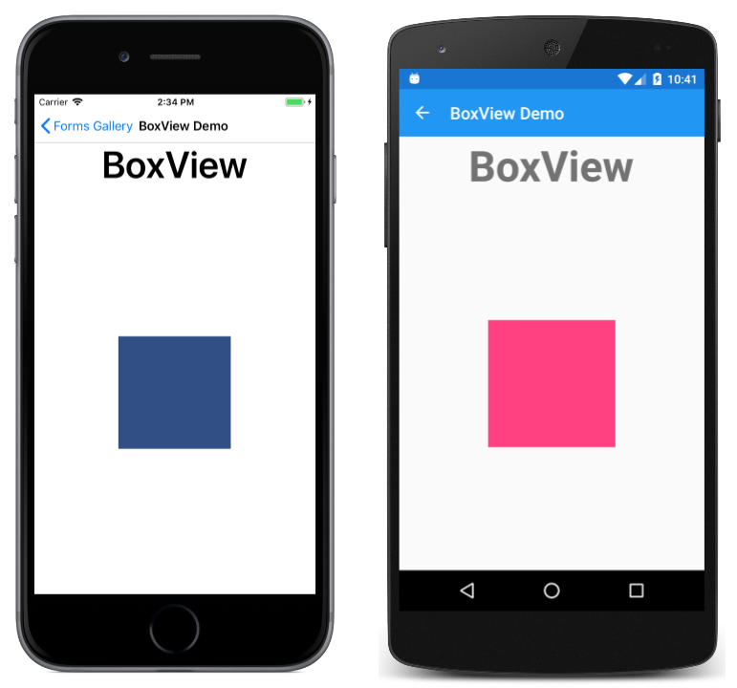
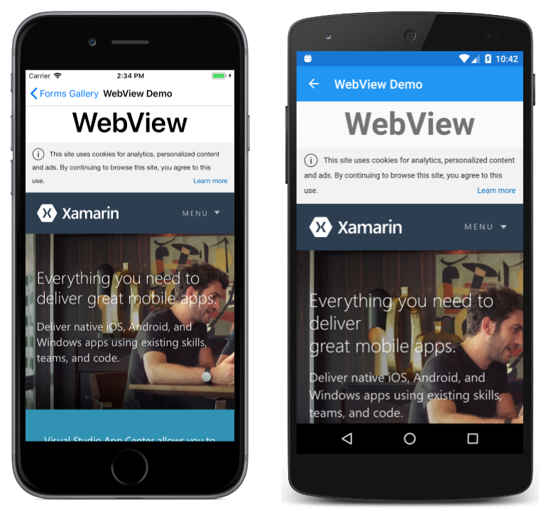
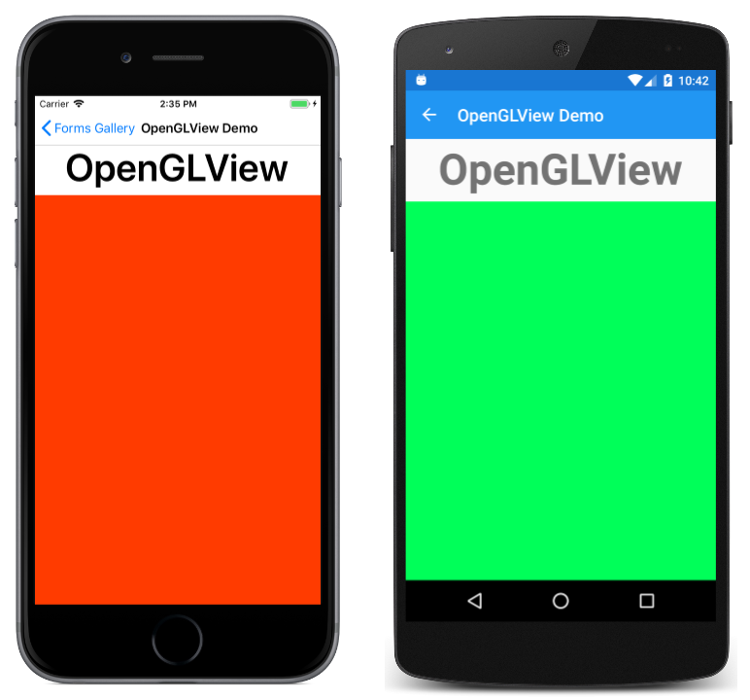
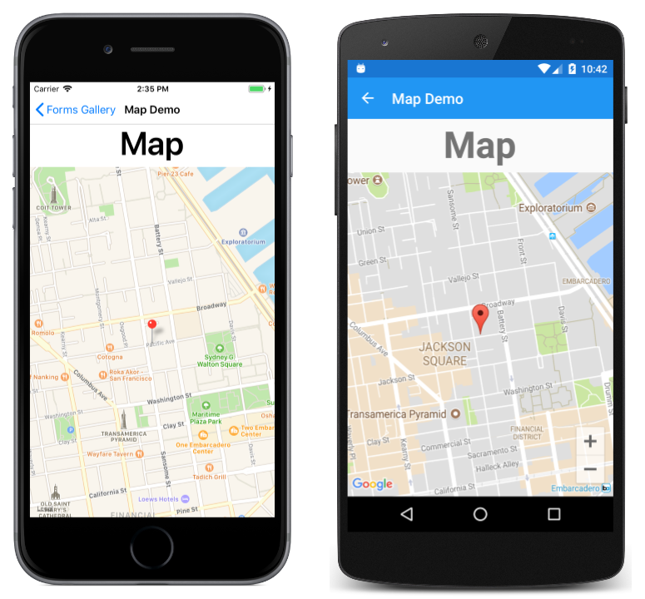
Content Presentation
Introduction
.NET MAUI
Setup
Layouts
Controls

Slide 32
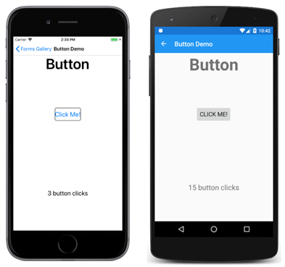
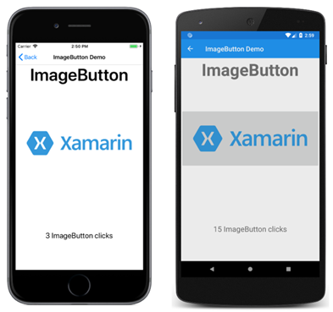
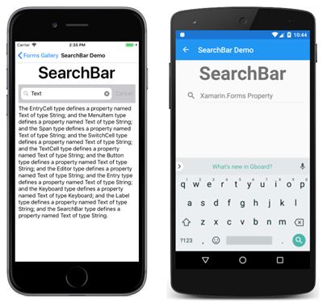
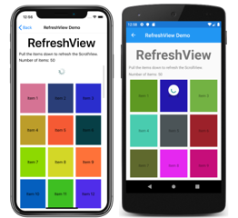
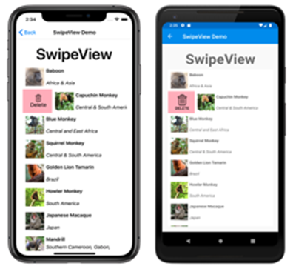
Actionable Controls
Introduction
.NET MAUI
Setup
Layouts
Controls

Slide 33
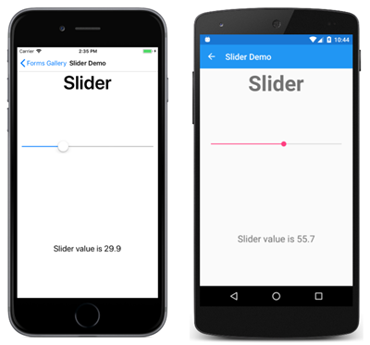
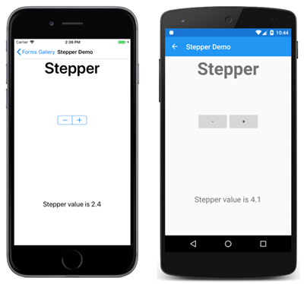

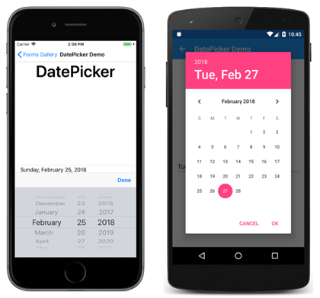
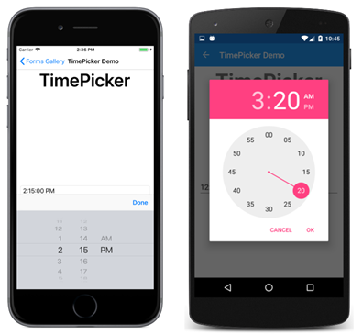
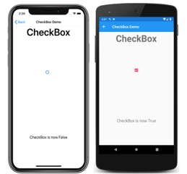
Setting Values
Introduction
.NET MAUI
Setup
Layouts
Controls

Slide 34
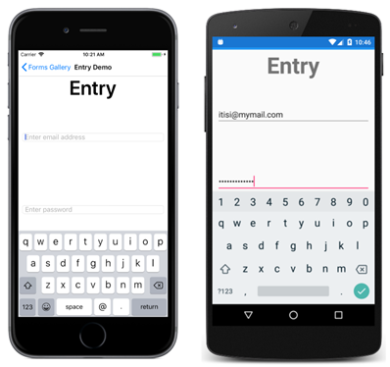
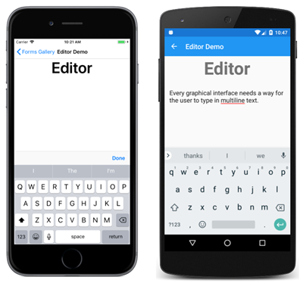
Editing Text
Introduction
.NET MAUI
Setup
Layouts
Controls

Slide 35
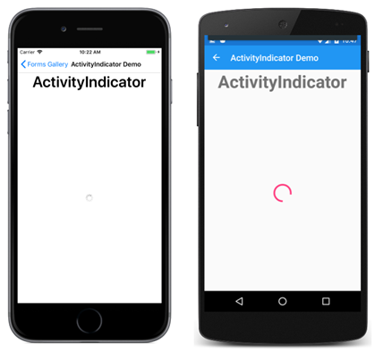
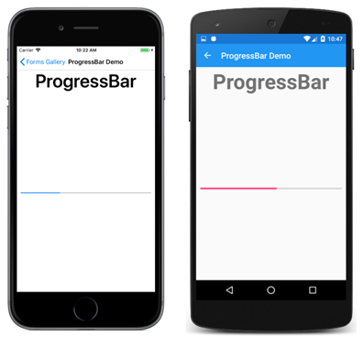
Activity Indication
Introduction
.NET MAUI
Setup
Layouts
Controls

Slide 36
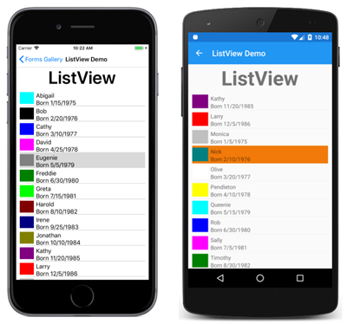
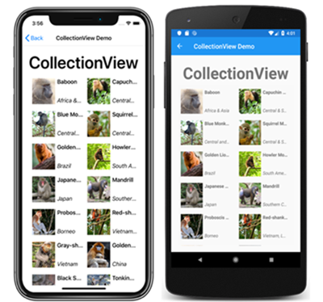
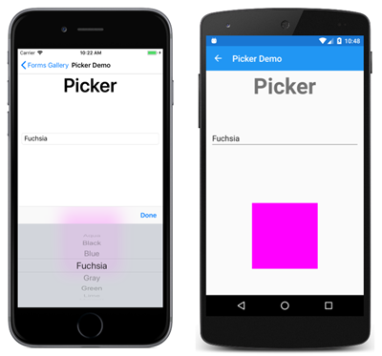
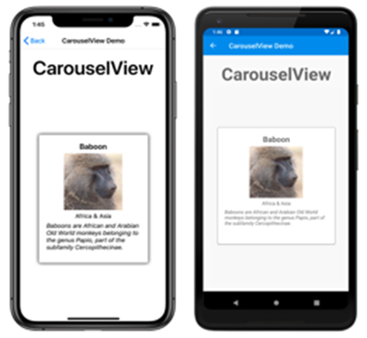
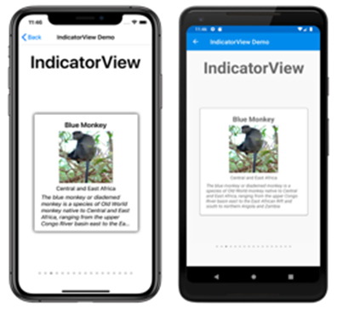
Collections
Introduction
.NET MAUI
Setup
Layouts
Controls

Slide 37
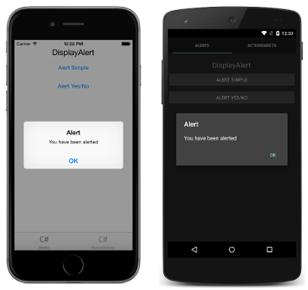
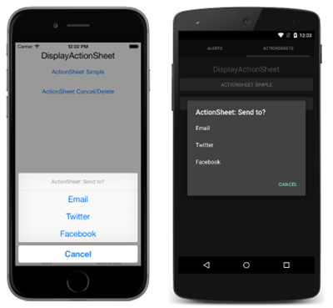
Pop-ups
Introduction
.NET MAUI
Setup
Layouts
Controls

Slide 38


Commercial components
Introduction
.NET MAUI
Setup
Layouts
Controls

Slide 39
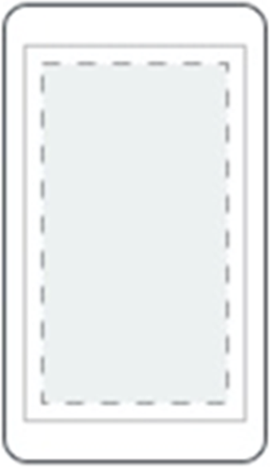

Pages
Bonus - Pages
ContentPage
Single content
FlyoutPage
Items + detail

Slide 40
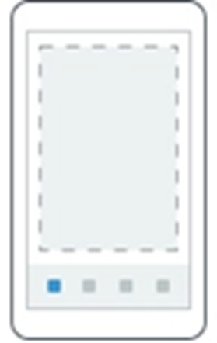
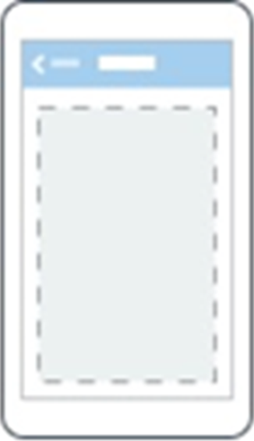
pages
Bonus - Pages
TabbedPage
Tabs
NavigationPage
Enables navigation

Slide 41
pages
Bonus - Pages
First displayed page is in App.xaml.cs
Default - MainPage
Notes:
Inside of a page are layouts
A lot of options from something simple like a stack panel to complex and powerful grids

Slide 42
Today’s goals
People introduction
Get in touch with .NET MAUI
Go through environment setup
Get to know available layouts and controls

